Slide 1
“ELECTRIFYING NEW GROWTH: WHAT DOES THIS MEAN?" Interim Report
Presented to the :
Concurrent City, County & Washoe County School District Meeting
May 4, 2015
May 4, 2015
Presented by:

Slide 2
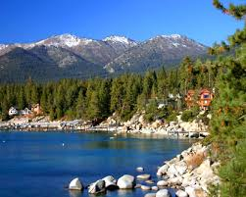
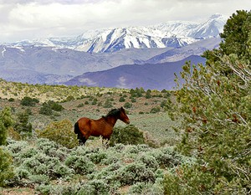
Part 1: The New Northern Nevada Economy

Slide 3
Background
Unprecedented Growth Is Projected For The Region: Tesla/Switch & Nearly 100 Other Announcements
What Are The Impacts Of This Growth On: Housing, Transportation, Workforce, Public Service Etc.?
Multiple Planning Organizations Were Providing Varying Projections On Job & Population Growth
Oct ‘14 EPIC Formed To Initiate The Coordination Of (Public / Non-profit / Private) Agencies To Develop A Single Consensus Report – RCG Was Commissioned
EPIC Technical Committee Met Weekly With RCG Economics To Gather Data & Provide Feedback

Slide 4
Significant Growth is Coming
Reno-Sparks MSA Projected Employment Growth: 2015-2019
Projected Job Growth Includes:
Tesla Primary & Induced
Historical Growth
EDAWN Projected Growth
1.2% Growth/Year
Sources: Bureau of Labor Statistics, EDAWN

Slide 5
EDAWN Jobs Announced: Ahead of 2015 goal
FY 2015 Goal
Source: EDAWN

Slide 6
EDAWN Hot Prospects! (Very Likely)
Industry | Job Count | HQ | Confidence | Relocation State
Manufacturing | 100 |  | Very Likely | TAIWAN
Service | 200 |  | May 13th | CA
Distribution | 80 |  | Very Likely | FL
Manufacturing | 100 |  | Very Likely | CA
Distribution | 50 |  | Very Likely | UT
Manufacturing | 50 |  | Very Likely | OH
Service | 100 | X | Very Likely | CA
Distribution | 50 |  | Very Likely | NV
Distribution | 100 |  | Very likely | MN
Service | 300 |  | Very likely | NY
Total | 1,130 | 1
Source: EDAWN

Slide 7
EDAWN Hot Prospects! (Probable)
Industry | Job Count | HQ | Confidence | Relocation State
Service | 500 |  | Finalist | OH
Manufacturing | 1,000 |  | Top Two | IL
Distribution | 800 |  | Top Two | PA
Manufacturing | 2,800 |  | Finalist | PA / VA
Data Center | 80 |  | Finalist | TX
Manufacturing | 500 |  | Finalist | NJ
Manufacturing | 700 |  | Finalist | SC
Manufacturing | 4,000 |  | New | IL
Manufacturing | 200 |  | New | IN
Total | 10,580
Source: EDAWN

Slide 8
Assumptions
Detailed Assumptions Provided In The Report
In Developing The Ranges For Job Growth Conservative Numbers Were Used
Job Growth, In Addition To Tesla, Was Included Based On EDAWN’s Estimates
Transportation Projects Projected To Be Completed In The Next 5 Years Were Considered
Study Area Based On Area Around Tahoe Reno Industrial Center & Reno / Sparks / Carson City

Slide 9
EPIC Members
Organizations
City of Reno
City of Sparks
City of Fernley
Washoe County
Storey County
University of Nevada, Reno
NV Energy
State Demographer
Washoe County School District
Reno Tahoe Airport Authority
RCG Economics, LLC
Governor’s Office of Economic Development
Economic Development Authority of Western Nevada
Truckee Meadows Regional Planning Agency
Center of Regional Studies, UNR
Regional Transportation Commission of Washoe County
NV Department of Employment, Training & Rehabilitation
Truckee Meadows Community College
Truckee Meadows Water Authority
Northern Nevada Development Authority
Western Nevada Development District

Slide 10
Scope of Work
Address The Community Growth Impacts On:
Fiscal (Public Revenues)
Socio-Economic / Housing / Schools
Traffic
Address 3 Scenarios High – Med - Low
Address A 5-Year Period 2015-2019
Provide Data On 5 Counties & 18 EPIC Zones
Collate Data From State & Local Agencies Addressing Planning & Projections
An Updated Report Is Projected in 18-24 Months

Slide 11
RCG Economics & John Restrepo 36 Years of Experience
RCG economics is one of the most authoritative sources of research & market trend analysis
They offer objective, independent strategic advice on economics, demographics, gaming, hospitality, real estate, & public policy issues
Research based on urban & regional modeling & economic / demographic projections
RCG clients include: Bank of Nevada, City of Las Vegas, Clark County, LVGEA, Wells Fargo, Washoe RTC, The Howard Hughes Corp., NDOT, UNLV, GOED

Slide 12
Part 2: The Nevada Economic Reality

Slide 13
Nevada job recoveries pre-Great Recession
Nevada Recession Recoveries: 1948-2001
Source: Bureau of Labor Statistics.

Slide 14
Nevada job recovery from Great Recession (after 94 months)
Nevada Recession Recoveries: 1948-Present
US
Nevada
Source: Bureau of Labor Statistics.

Slide 15
State taxable sales near all-time high thanks to economic recovery & visitors
Nevada, Clark & Washoe Counties Taxable Retail Sales: Jan-06 to Jan-15
Source: Nevada Department of Taxation.

Slide 16
Gaming revenues returned moderately due to baccarat; slot revenues stagnant
Nevada, Las Vegas & Reno Gaming Revenues-W/O Baccarat: Feb-06 to Feb-15
Source: Nevada Gaming Control Board.

Slide 17
Reno visitor volume up modestly
Reno-Sparks Monthly Visitor Volumes: Feb-06 to Feb-15
Source: Reno-Sparks Convention & Visitors Authority.

Slide 18
Home affordability suffered during Great Boom, now near US avg, but??
Reno-Sparks MSA Home Prices: Jan-10 to Jan-15
Source: Center for Regional Studies-UNR.

Slide 19
The Reality: Nevada Population & Jobs

Slide 20
The “headline” unemployment rate continues to drop
Nevada & Study Area Unemployment Rate: Feb-06 to Feb-15
Feb-15 Study Area: 7.5%
Feb-15 NV: 7.5%
Source: Bureau of Labor Statistics.

Slide 21
& “real“ wages in Nevada finally rising Reno-Sparks doing even better
Real Average Weekly Earnings ($2007): Feb-08 to Feb-15
Source: Bureau of Labor Statistics.

Slide 22
Slack remains in Nevada job market but Reno-Sparks is improving significantly
Nevada & Reno MSA Average Weekly Hours: Feb-08 to Feb-15
Source: Bureau of Labor Statistics.

Slide 23
Northern Nevada Growth Forecast: Tesla & Natural Growth

Slide 24
New Tesla battery plant will help bring thousands of needed jobs to Nevada
Tesla Gigafactory Facts:
Goal: Produce batteries for cars /homes / others
6,500 jobs at buildout; 7,646 indirect & induced jobs
Nucleus of new economic cluster for the state
Factory to use economies of scale to reduce costs of lithium-ion batteries
By 2020, should more than double the world production of lithium-ion battery production of 2013
Tesla Just Announced the “Powerwall” stackable battery system to store electricity for homes, businesses and the grid
Source: Tesla Motors.

Slide 25
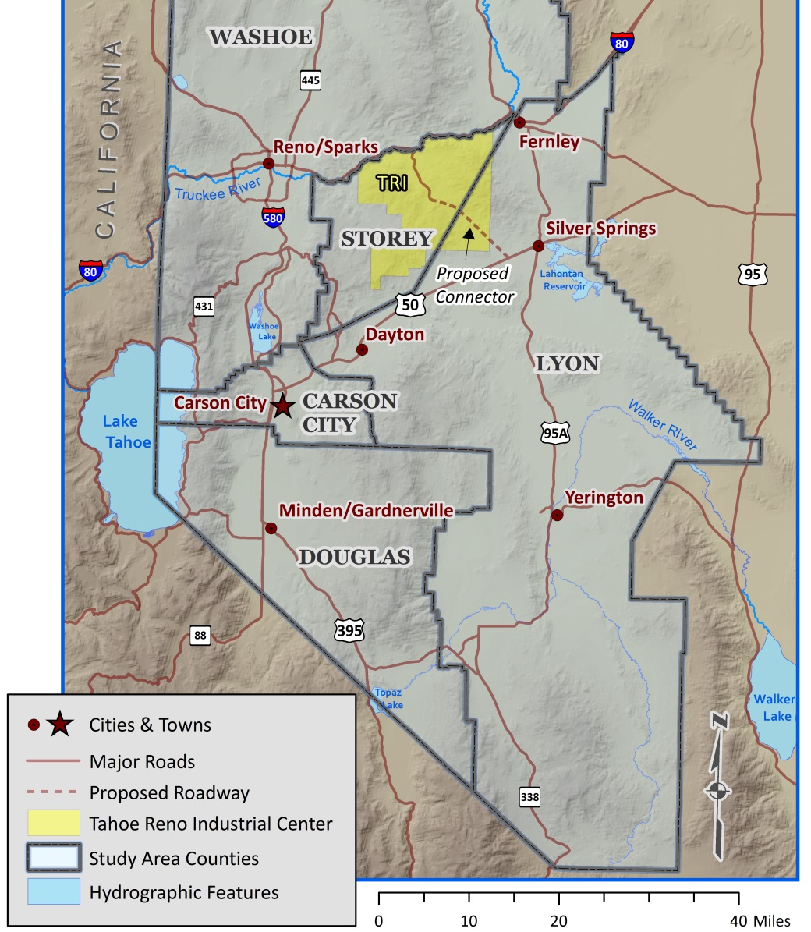
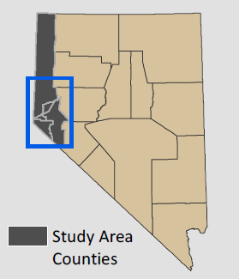
Study Area consists of 5 counties
Study Area Map – Study Period: 2015-2019
Source: Nevada Economic Planning Indicator Committee (EPIC).

Slide 26
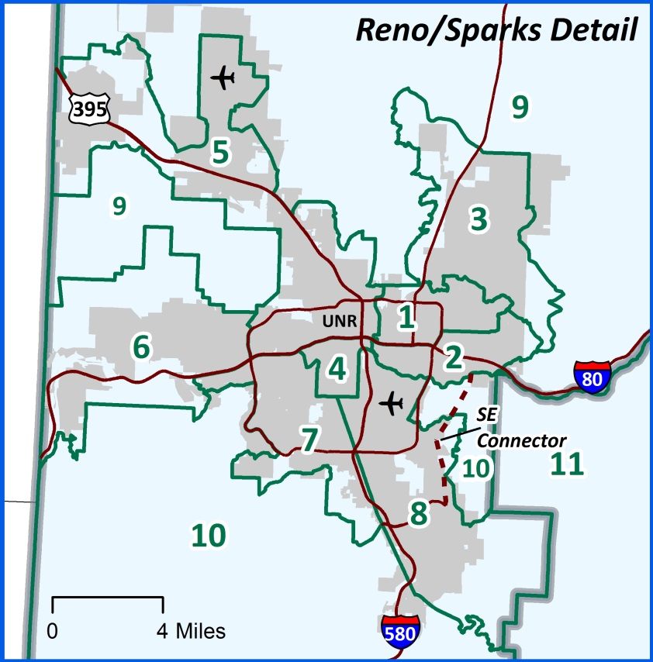
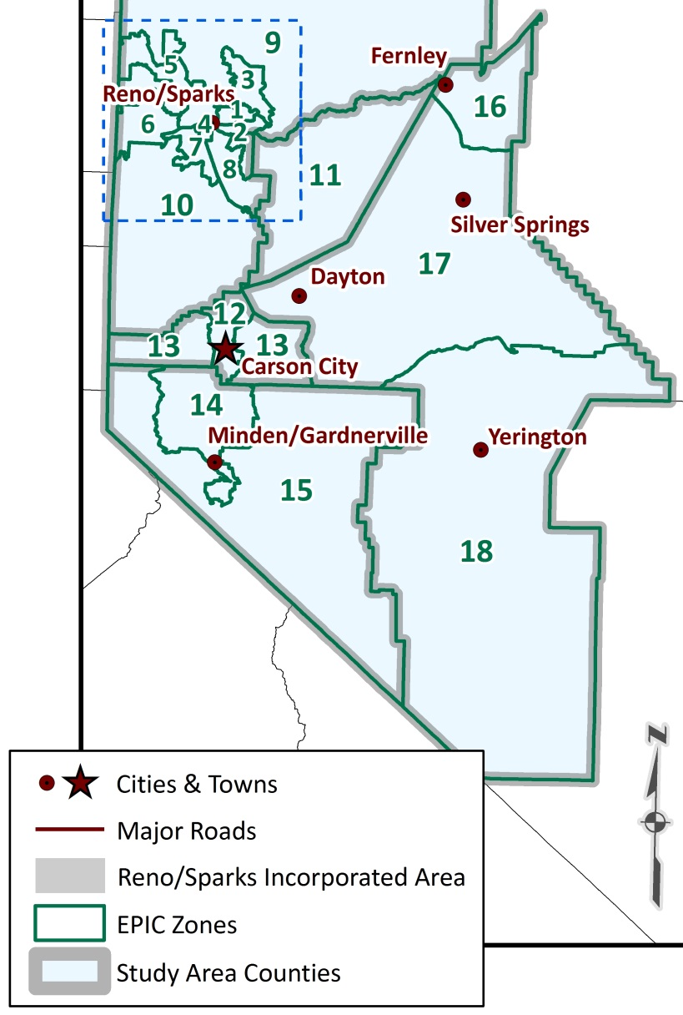
Study Area also divided into 18 “EPIC Zones”
Study Area Zone Index Map: 2015
Source: Nevada Economic Planning Indicator Committee (EPIC).

Slide 27
18 EPIC Zones called . . .
Study Area Zone Index IDs
ID | EPIC Zone
 | Washoe County
1 | Sparks
2 | Sparks Industrial
3 | Sparks Suburban
4 | Downtown Reno
5 | North Reno
6 | West Reno
7 | Southwest Reno
8 | Southeast Reno
9 | North Washoe
10 | South Washoe
 | Storey County
11 | Storey
 | Carson City County
12 | Carson City
13 | Carson City - Rural
 | Douglas County
14 | Douglas
15 | Douglas – Rural
 | Lyon County
16 | Fernley Area
17 | Central Lyon
18 | South Lyon
Source: Nevada Economic Planning Indicator Committee (EPIC).

Slide 28
Scenario B 5-Yr growth: 52K jobs, 42K persons & nearly 17K households
Source: Nevada Economic Planning Indicator Committee (EPIC).

Slide 29
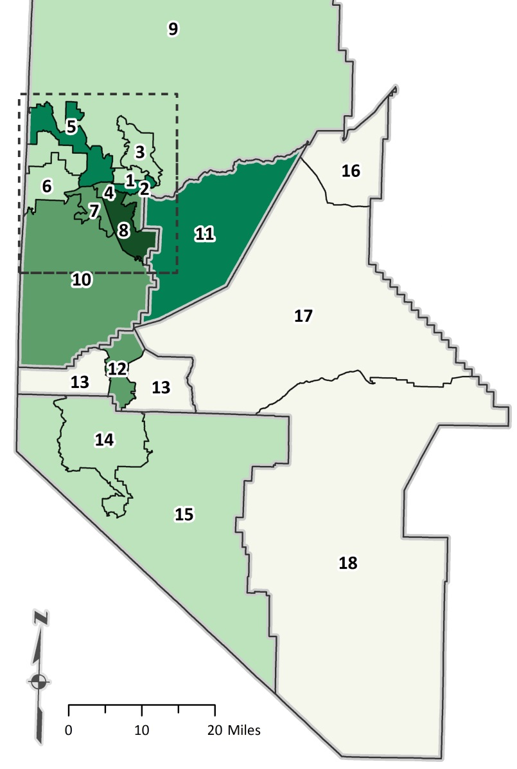
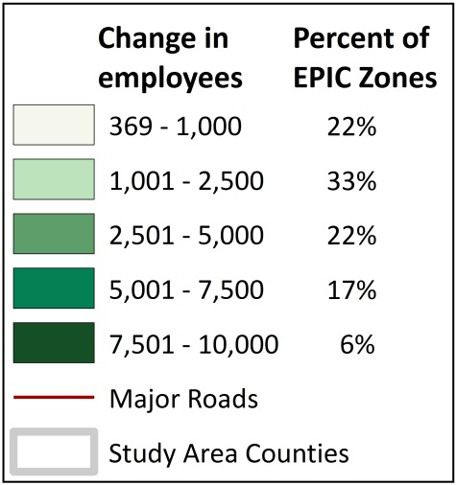
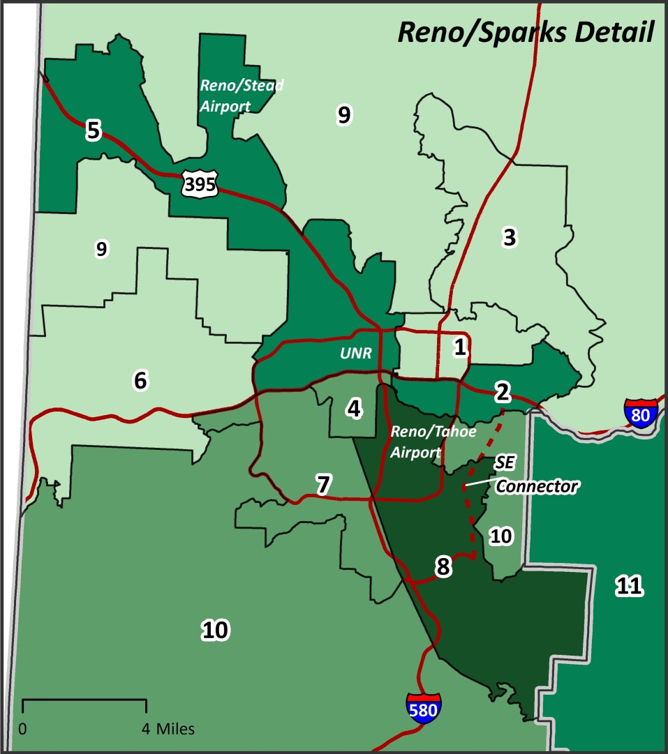
Scenario B job growth concentrated in 4 Zones
Total Projected Employment Growth Map-Scenario B, by EPIC Zone: 2015-2019
Source: Nevada Economic Planning Indicator Committee (EPIC).

Slide 30
Scenario B employment growth concentrated in 4 Zones
Projected Employment Growth Conclusions: 2015-2019
4 zones contain over half of the growth
Zone 2: Sparks Industrial – 6,107 jobs
Zone 5: North Reno – 5,585 jobs
Zone 8: Southeast Reno – 9,104 jobs
Zone 12: Storey County – 5,478 jobs
Other notable gains
Zone 4: Downtown Reno – 4,143 jobs
Zone 7: Southwest Reno – 3,762 jobs
Zone 10: South Washoe – 3,009 jobs
All zones gain jobs over study period
Source: Nevada Economic Planning Indicator Committee (EPIC).

Slide 31
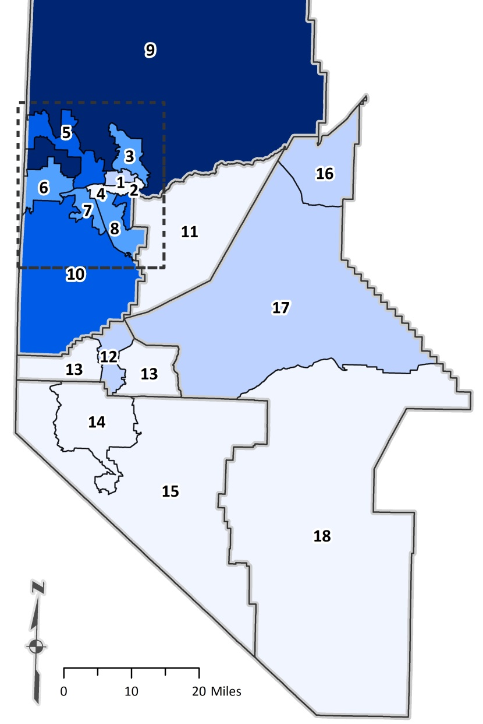
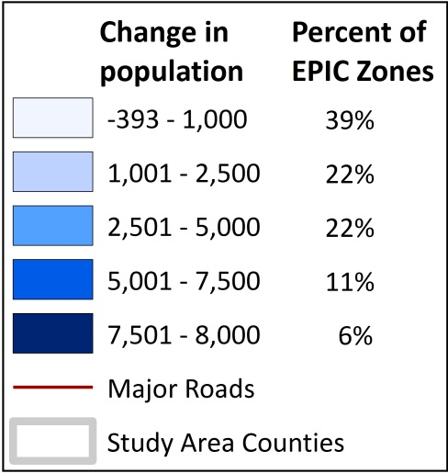
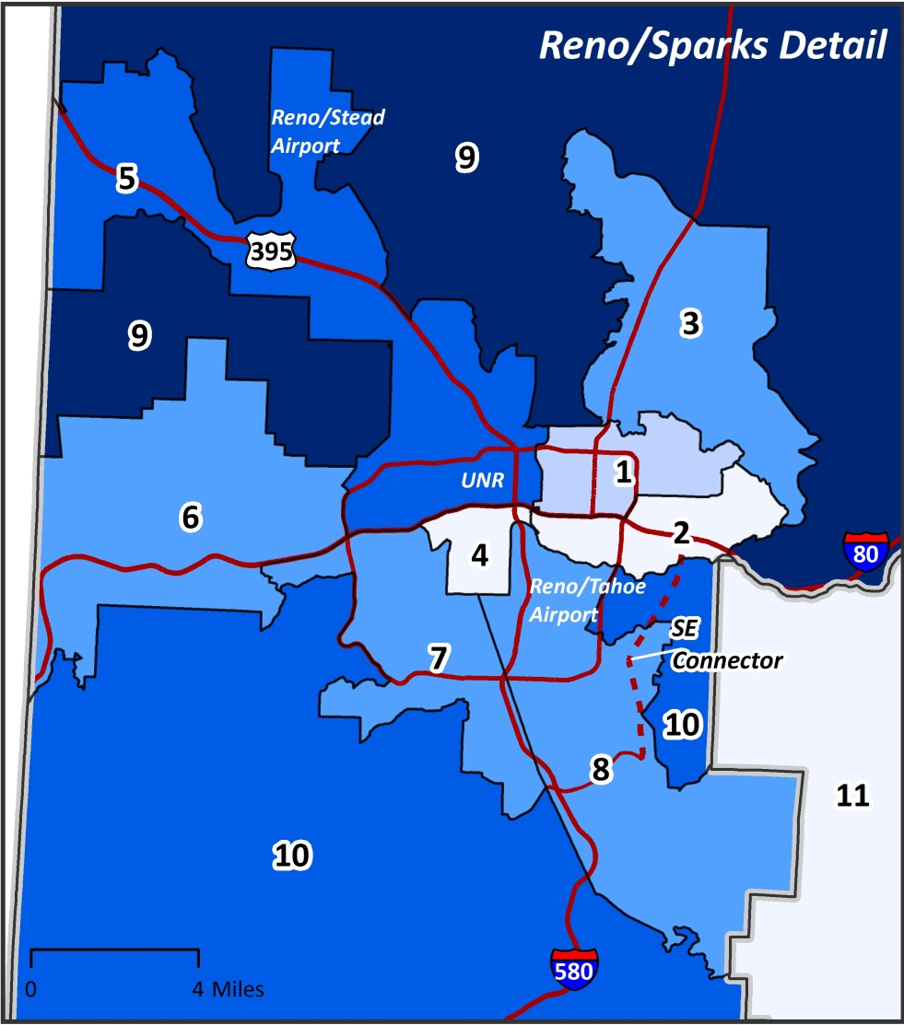
Scenario B population growth centered around Reno-Sparks MSA
Total Projected Population Growth Map-Scenario B, by EPIC Zone: 2015-2019
Source: Nevada Economic Planning Indicator Committee (EPIC).

Slide 32
Scenario B population growth concentrated in 3 Zones
Projected Population Growth Conclusions: 2015-2019
3 zones encompass nearly half of the population growth
Zone 5: North Reno – 6,738 persons
Zone 9: North Washoe – 7,608 persons
Zone 10: South Washoe – 5,765 persons
Rest of population growth spread out
Zone 3: Sparks Suburban– 4,242 persons
Zone 6: West Reno – 2,632 persons
Zone 7: Southwest Reno – 3,323 persons
Zone 8: Southeast Reno – 4,016 persons
Zone 12: Carson City – 2,176 persons
Douglas County expected to lose 393 persons, but will start growing in 2017
Source: Nevada Economic Planning Indicator Committee (EPIC).

Slide 33
Questions?

Slide 34
Contact Us
John Restrepo jrestrepo@rcg1.com www.rcg1.com Twitter: @rcgeconomics
Mike Kazmierski
kazmierski@edawn.org
www.edawn.org
Jeremy M. Smith, Ph.D.
jsmith@tmrpa.org
http://www.tmrpa.org/

